Slide 1
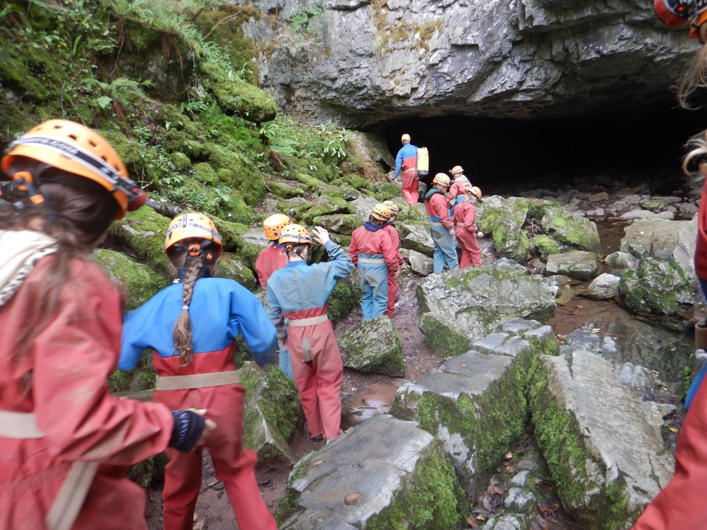
Brecon Beacons, Year 6 residential
Notes:
Need:
Class list to check people off
Parent info sheets
Timetable (proposed)
Notes for each slide

Slide 2
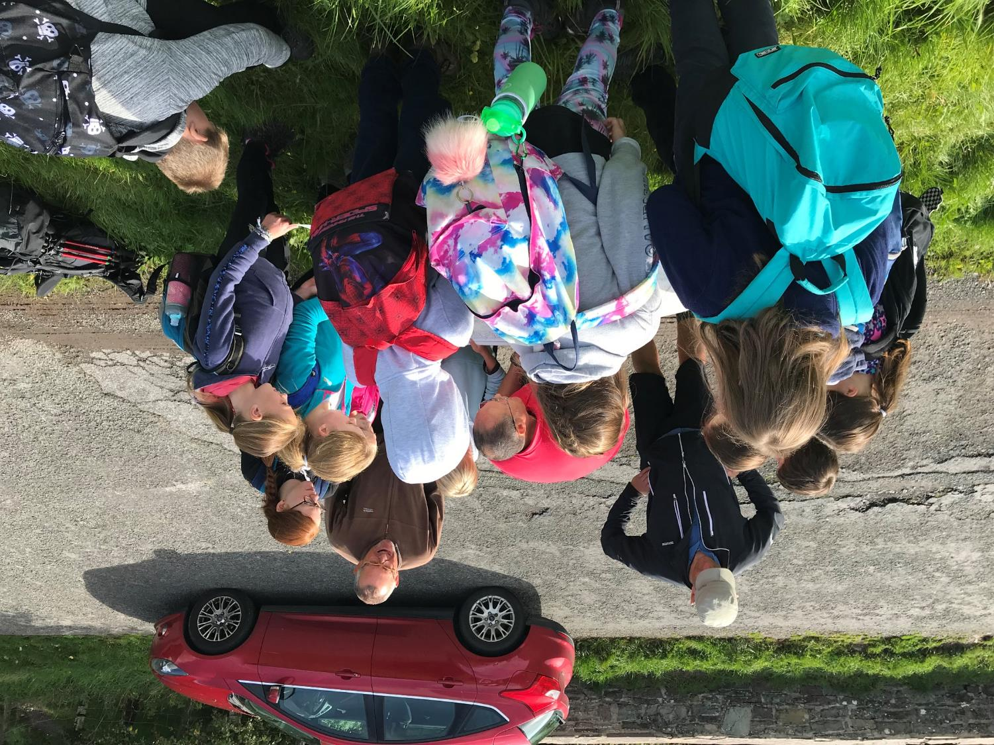
Why Wales?
Personal and Social development
Environmental study
River study
Geographical and geological study
New and unfamiliar
Landscape
More challenging ‘real life’ activities
Notes:
Getting to the heart of a residential experience away from home
Preparation for the next steps in life
Puts learning from school into a real life context – living the motto
Independent skills
Cooking
Cleaning
Tidying
Teamwork
NO public access
Safer – altogether in one building
Activities can be tailored so they’re not daunting for children
Save costs – travel would have taken us to almost £300 per child
Tailored for US
Your child being confident!

Slide 3
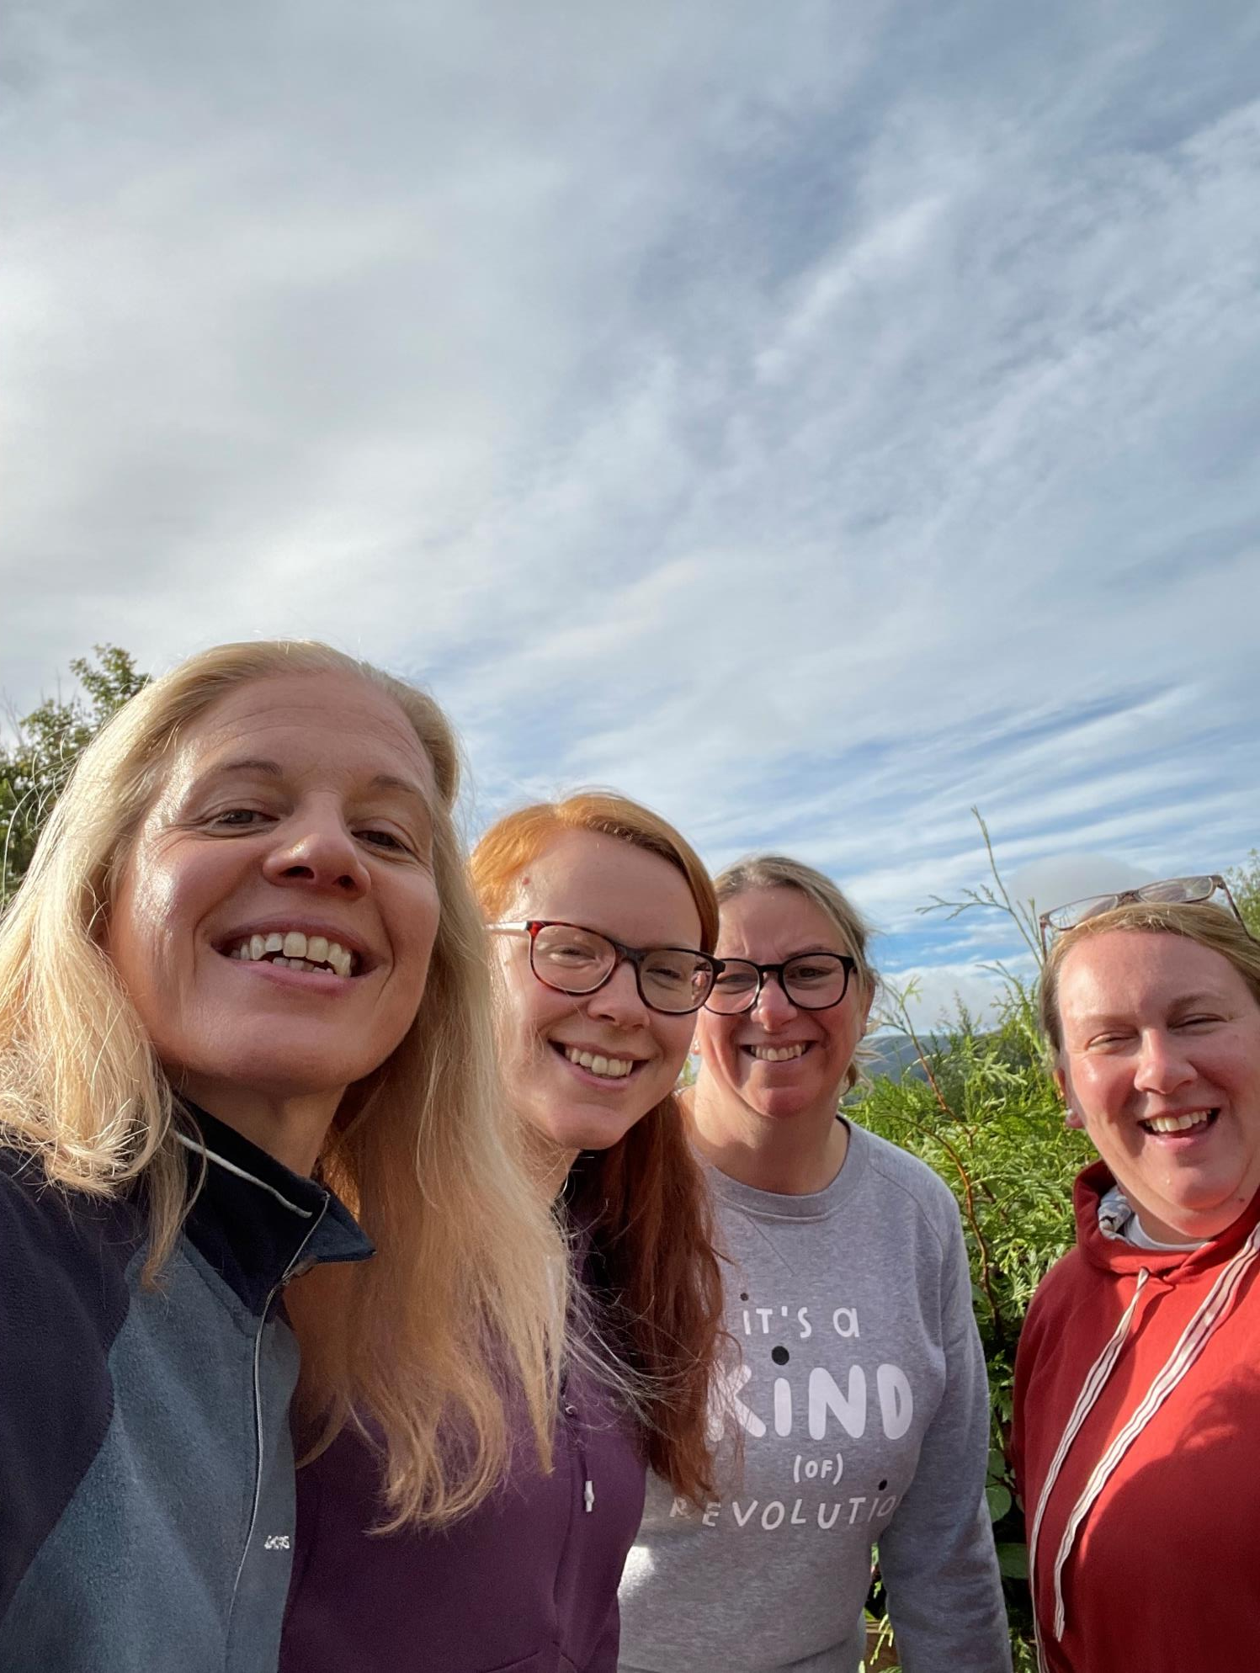
Who’s on our team?
Mrs Jefferies
Mrs Holdich
Miss Morris
Mrs Thomas? Mrs Freeman?
Notes:
Frightening thought how much combined experience there is amongst the group!

Slide 4
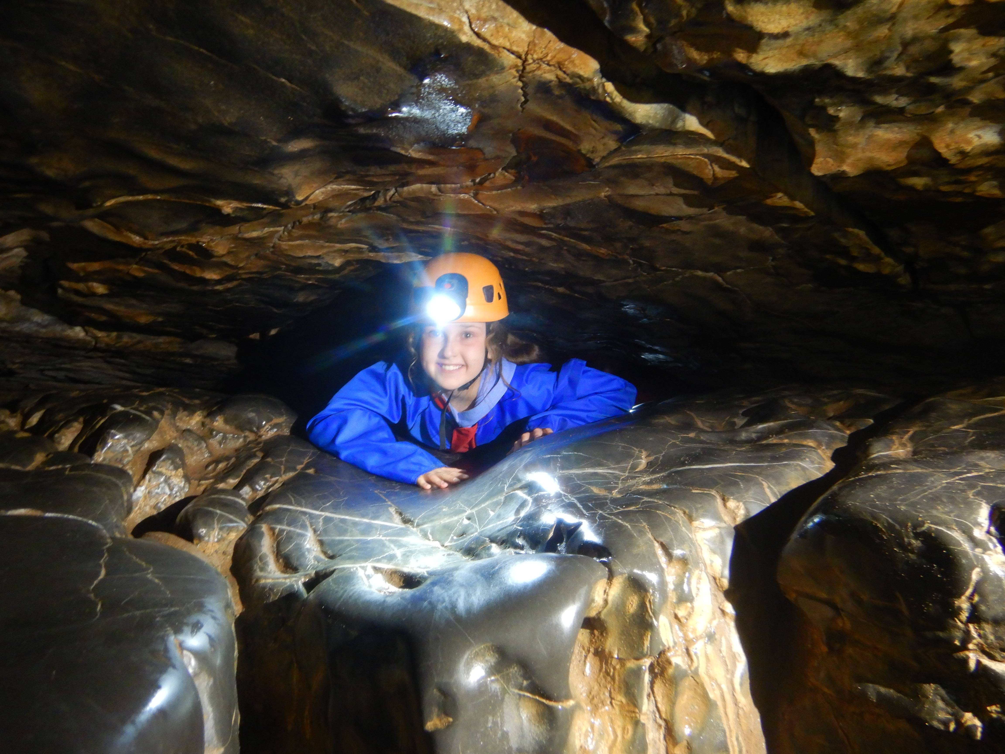
What will we get up to?
Mountain walking – Orienteering, map skills
Art in the environment
Caving
Waterfall/river walk
Canoeing
Climbing in a quarry or at Dinas rock
Notes:
Frightening thought how much combined experience there is amongst the group!

Slide 5
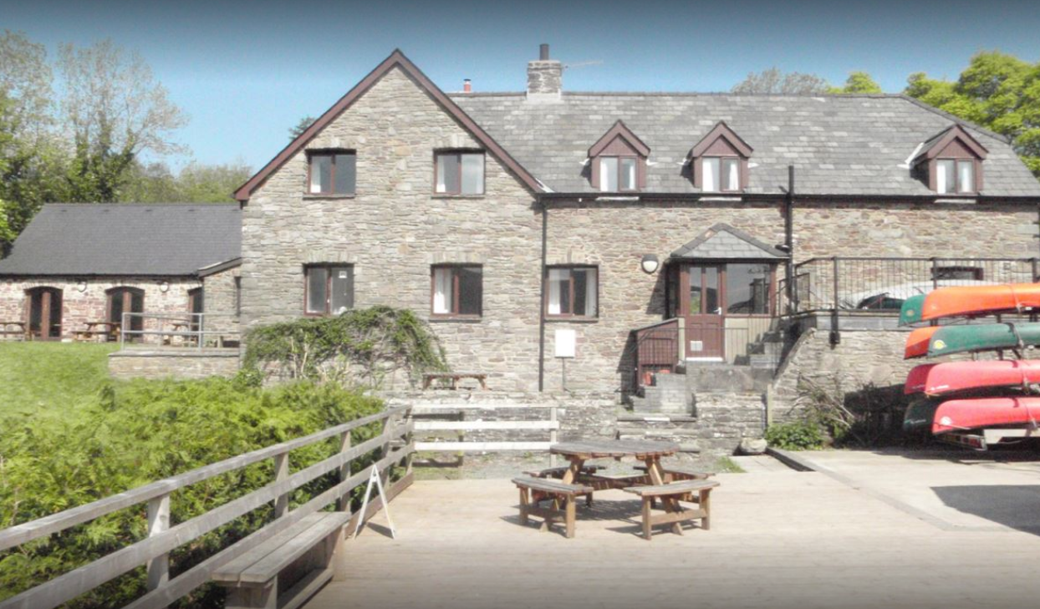

What about accommodation?
Notes:
Have a huge sports hall
Lounge area
Many smaller bedrooms
Girls floor and boys floor
Kitchens and comfy chairs
Private garden
BBQ area

Slide 6
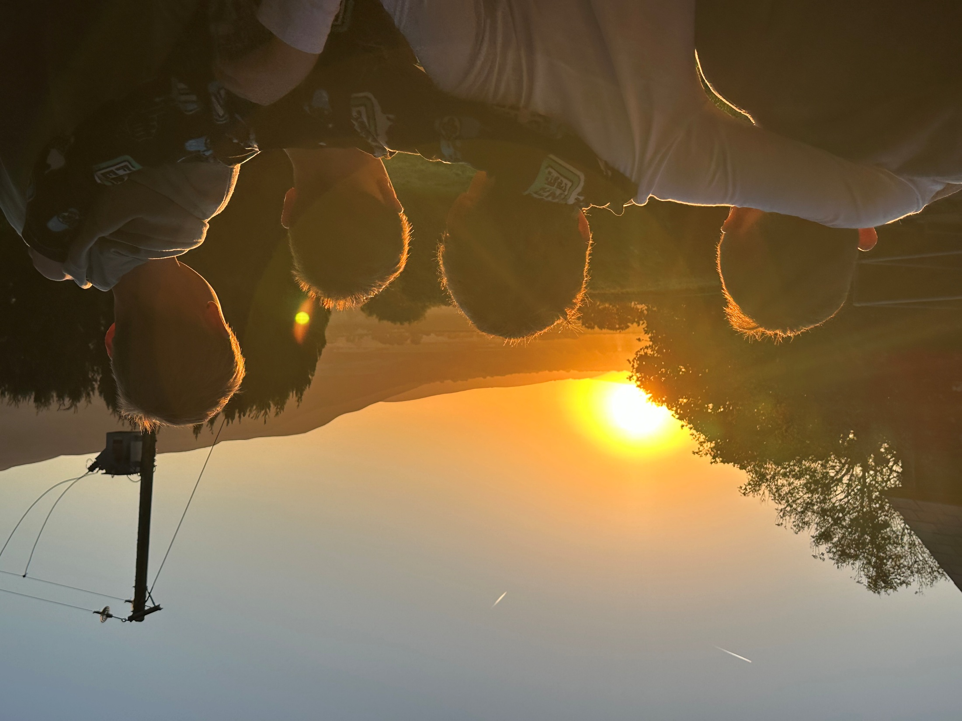

Slide 7
Sleeping (or trying to!)
Boys | Girls
10 boys | 9 girls
3-4 rooms | 2 rooms
?
?bedwetting
?periods
?sleep walking
Notes:
Go through how people will be chosen if the children decide to split rooms
Dble check on bed wetting etc
Gd floor with most children for fire exit
Adult on each floor

Slide 8
Practical bits and pieces
Transport – 2 x minibus
Clothing – essentials (boots there)
Food/snacks: a little something from home
Food allergies
Medical form emergency contact details
Us contacting you
Notes:
Go through booklet with parents
Hand out medical and swimming forms

Slide 9
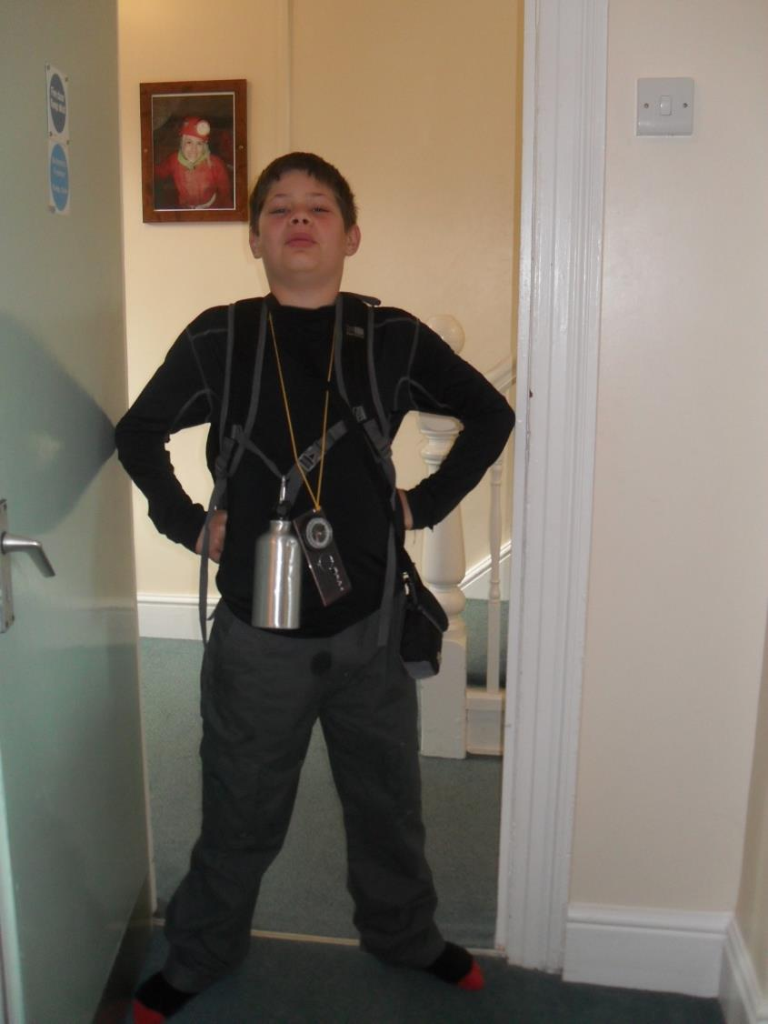
The essential kit list
It MUST FIT
It could be rain, sun, wind, snow
Footwear
Waterproofs
Layers

