Slide 1
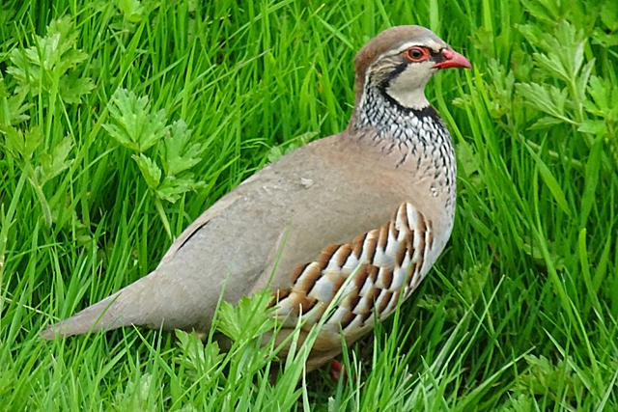
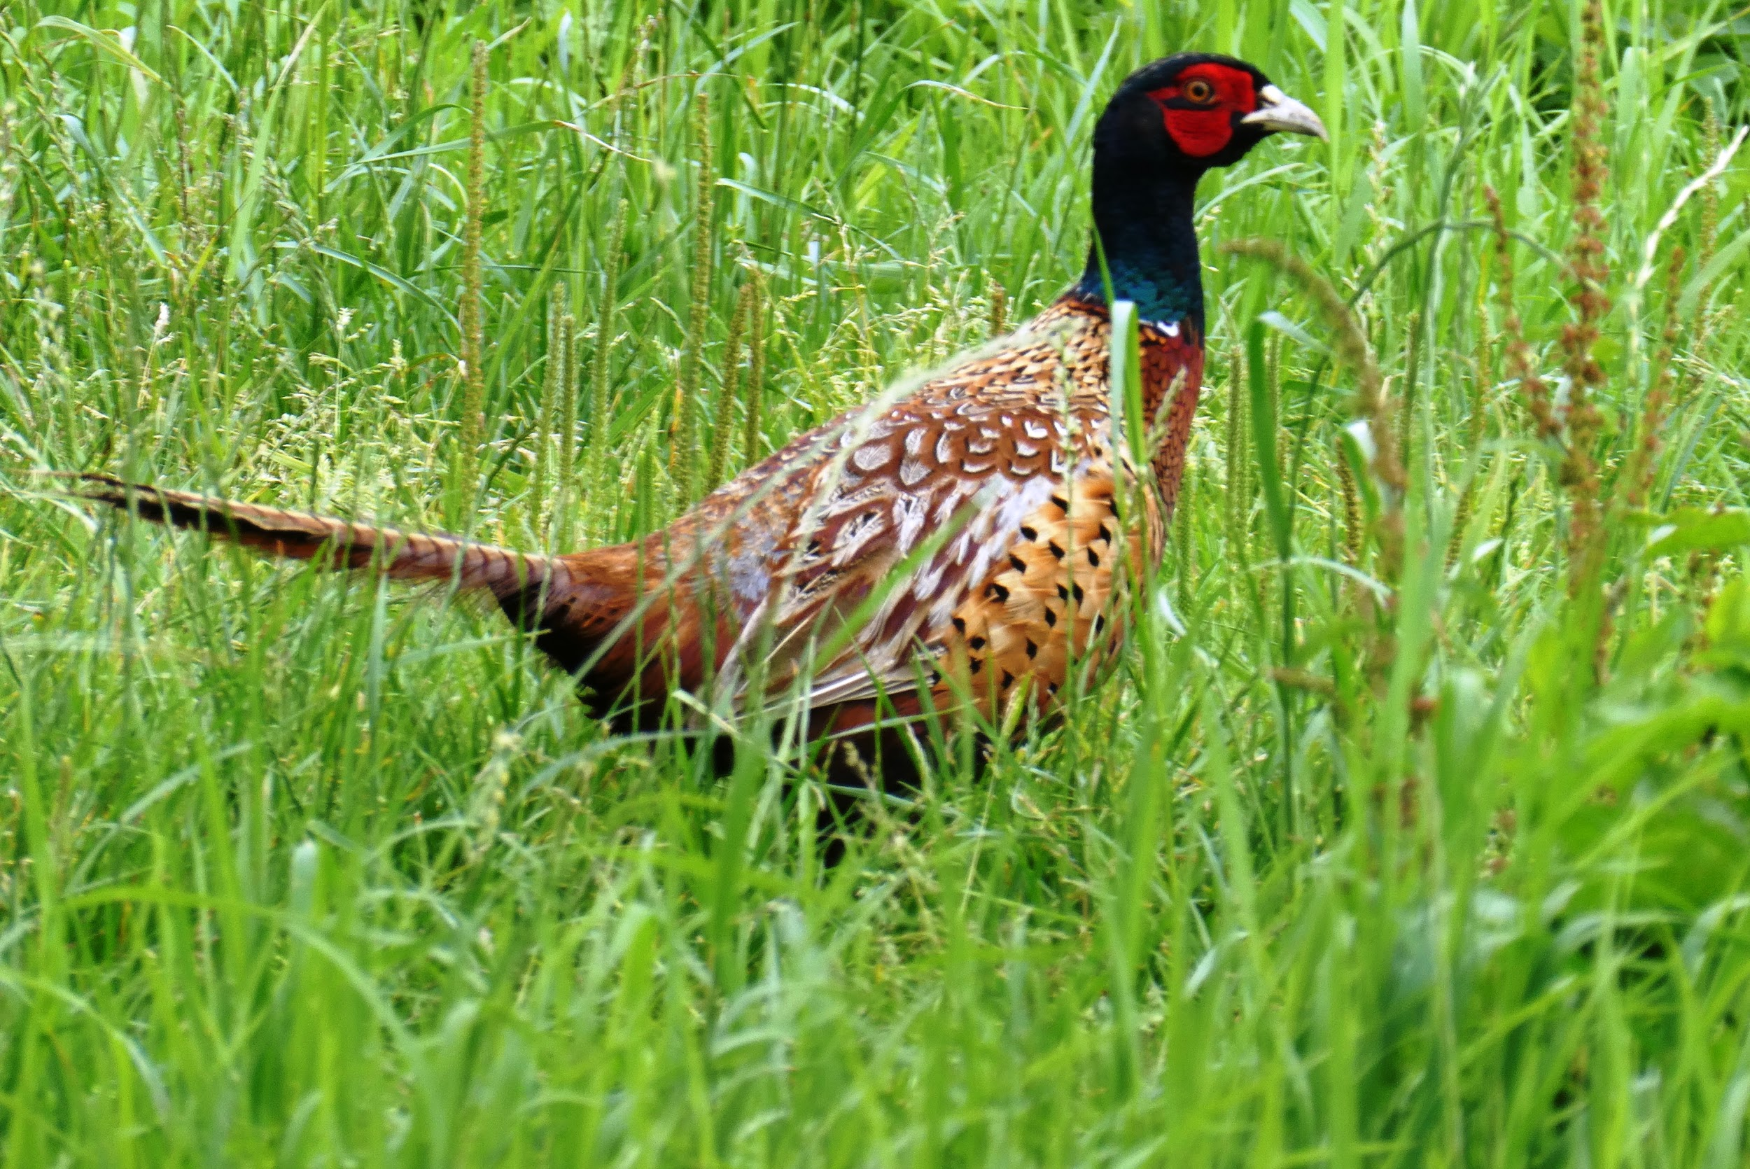
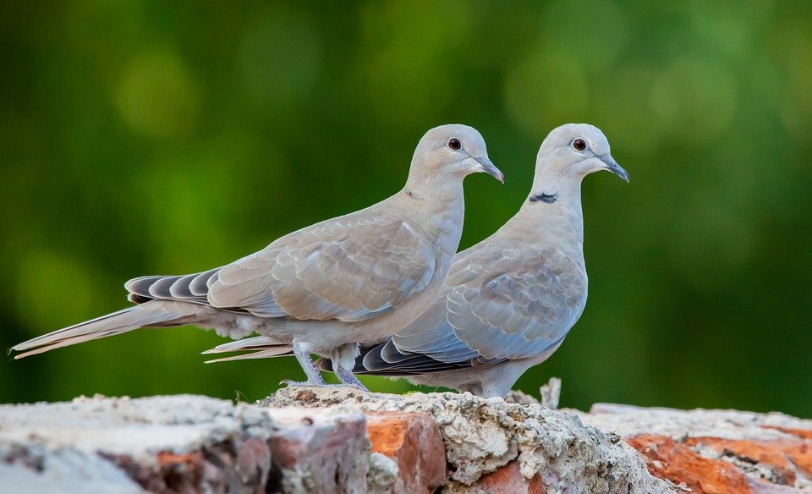
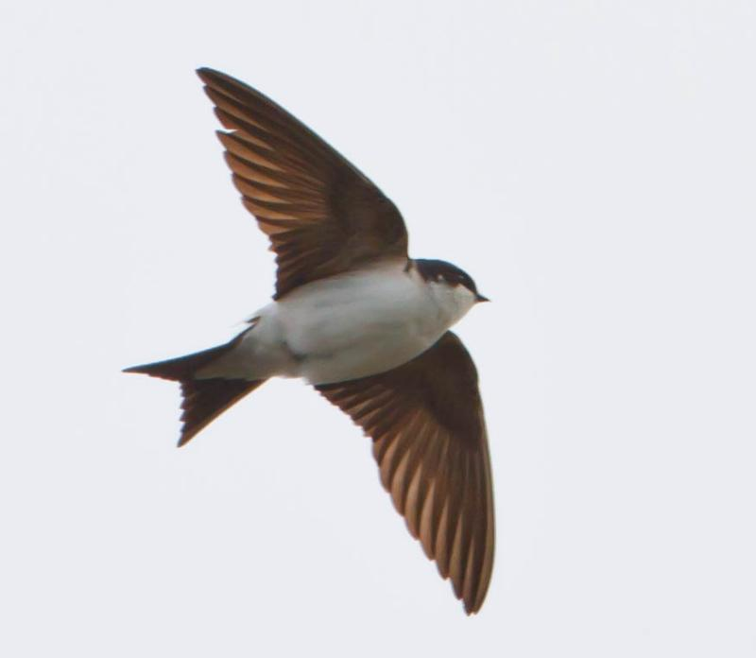
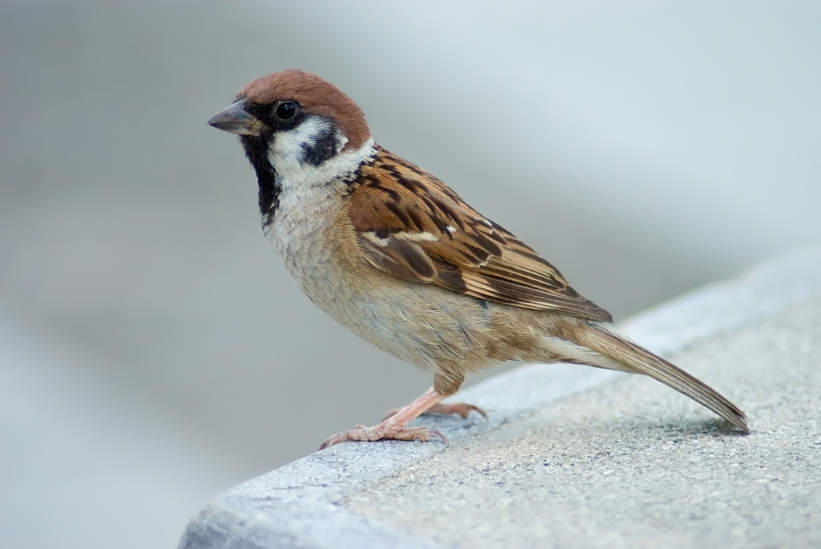
Birds in my garden
By Beth Blyth

Slide 2
Doves
Doves are the same family as pigeons they are called Columbidae and have many similar features.
Doves are slightly smaller than pigeons but have longer tails.
Doves are the only bird in the world that do not need to lift their head to swallow water
Doves are a symbol of peace and luck.
White doves are used at weddings.
They are hardy birds that can live in desert areas, tropical rain forests, mountains and woodlands.

Slide 3
Sparrows
Sparrows are small birds and they can grow up to 4 to 8 inches
Male and female can be distinguished by the feather coloration: males have reddish backs and a black bib, while females have brown backs with stripes.
Sparrows are very social and they live in colonies called flocks.
Sparrows life span is around 4 to 5 years
Sparrows usually build their nests under roofs , under bridges and tree hollows.
Sparrows are not territorial animals , but protect their nest from other sparrows.

Slide 4
Pheasants
Female and male pheasants both have different colouring: males usually have a blue head with a brown and an orangey colour on their backs and females usually have have brown heads and stripy brown backs.
Pheasants can survive up to 3 years if their lucky: some pheasants only survive up to 6 - 10 weeks, sadly.
Pheasants are commonly found in farm land and woodlands throughout the UK
They only eat seeds, berries, leaves and insects.
Pheasants roost in trees.

Slide 5
Housemartins
Housemartins are in the same family as sparrows
The housemartins is a small bird with glossy blue-black upper parts and pure white under parts.
They are summer migrants and spend the winters in Africa.
They eat insects like worms
They grow up to 12 cm in length, their wings usually grow up to 26-29 cm and there weight can weigh 15-23 g
They can often be seen perched on telegraph wires close to their nest.

Slide 6
French Partridge
French partridges eat a mixed diet off leaves, chiefly,roots, seeds and occasionally insects especially when feeding chicks.
A baby Partridge is called a cheeper.
They can fly up to 30-35 mph They are slower than a pheasant, but it is the size off the bird that makes it seem as though they are flying faster.
When they grow up they have red claws
Some french Partridges nest on the ground.

